Slide 1

Ultron
Product UX Walkthrough
October 2026
Version 3
Internal use only

Slide 2
Domain model
From a governed change plan to evidence at the point of execution
For Operations: each level answers a different question and keeps ownership, status and recovery clear.
LEVEL
THE QUESTION IT ANSWERS
WHAT IT HOLDS
PLAN
What change are we delivering?
Operation type, change record and approved window. Contains one or more plan items.
PLAN ITEM
Which target is affected?
One independently tracked target, such as an F5 tenant or device, and its target firmware version.
WORKFLOW
How is the outcome orchestrated?
Durable execution sequence and runtime state. A Plan Workflow coordinates the plan; each item has its own workflow.
TASK
Which meaningful stage is running?
A visible execution stage. Retry, rollback or cancel is applied to the specific failed task.
MILESTONE
What exactly happened?
Granular checkpoint with timestamps, evidence and precise failure-point visibility.
Internal use only

Slide 3
Overview
The journey at a glance
Eight steps take a plan from the Plans list to its outcome. The slides that follow walk through each one.
01
02
03
04
05
06
07
08
Find your work
Create the plan
Add items
Submit and validate
Wait for the window
Run and monitor
Handle exceptions
See the outcome
Open Plans and pick up what needs you
Choose each target and check its impact
Name it, pick the operation, link the change
The system checks the plan and every item
Validated and waiting for the change window
Items run in parallel; follow the progress
Decide on any task that stops
Completed, or completed with failures
Internal use only

Slide 4
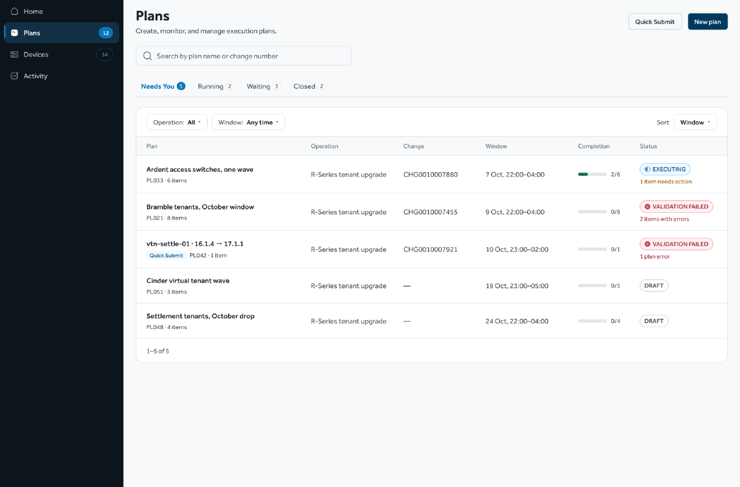
Create the plan
Start with a new plan
Name the plan, choose the operation and link the change record. One plan holds one operation and one change window.
STEP 1 OF 8
Find your work
Create the plan
Add items
Submit and validate
Wait for the window
Run and monitor
Handle exceptions
See the outcome
Internal use only

Slide 5
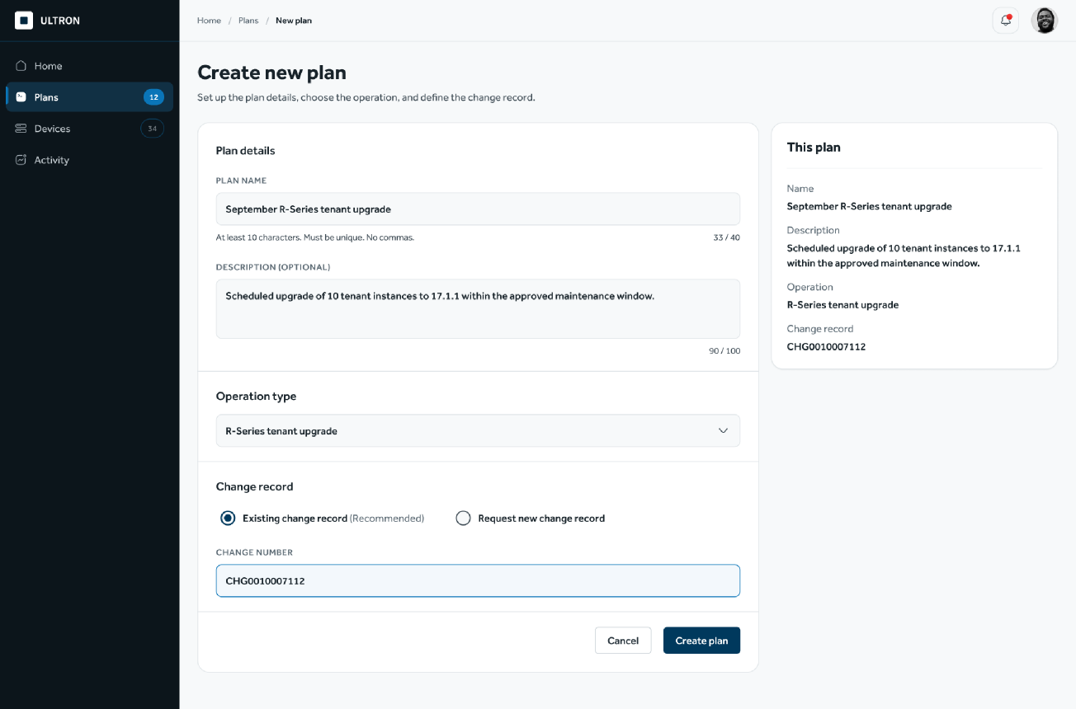
Create the plan
Start with a new plan
Name the plan, choose the operation and link the change record. One plan holds one operation and one change window.
STEP 2 OF 8
Find your work
Create the plan
Add items
Submit and validate
Wait for the window
Run and monitor
Handle exceptions
See the outcome
Internal use only

Slide 6
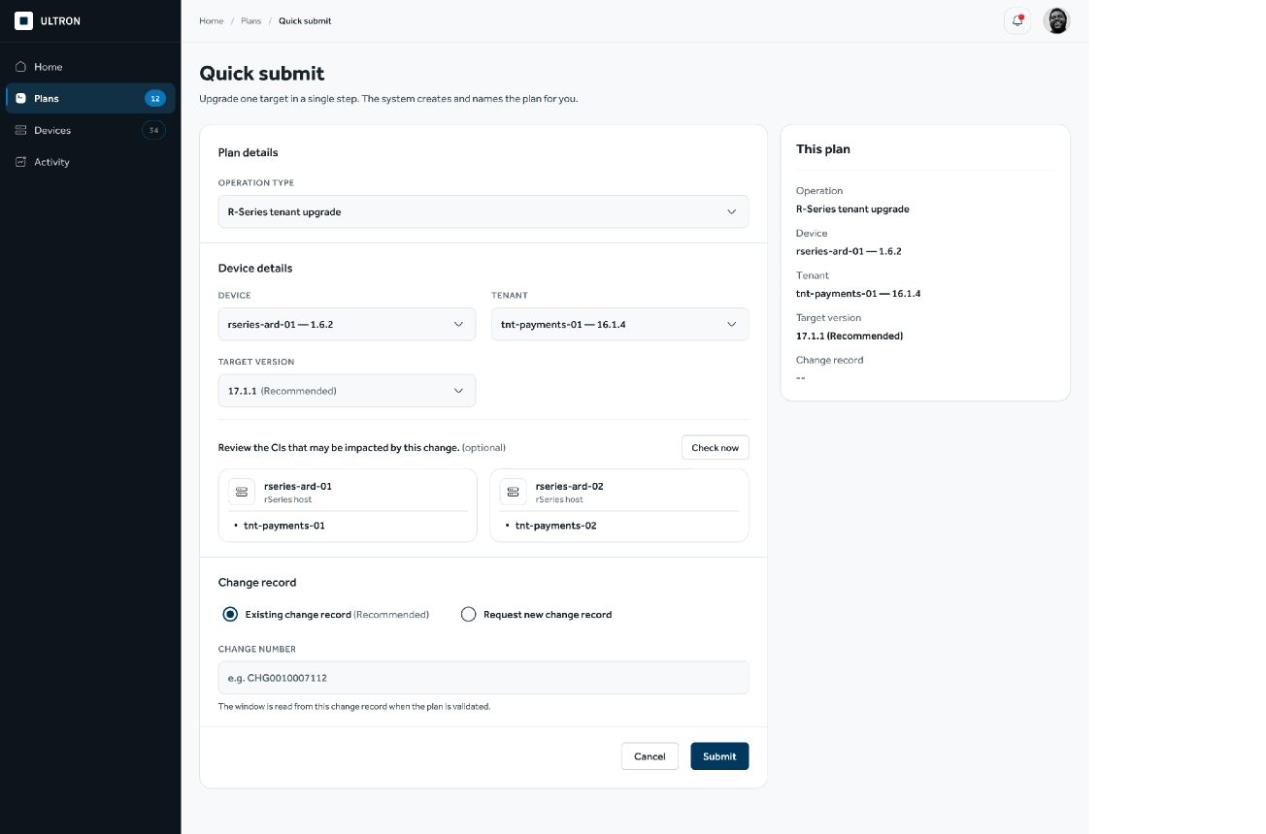
Create the plan
Quick Submit for a single change
For one target, the same checks happen on a single screen. The system creates the plan in the background.
STEP 2 OF 8
Find your work
Create the plan
Add items
Submit and validate
Wait for the window
Run and monitor
Handle exceptions
See the outcome
Internal use only

Slide 7
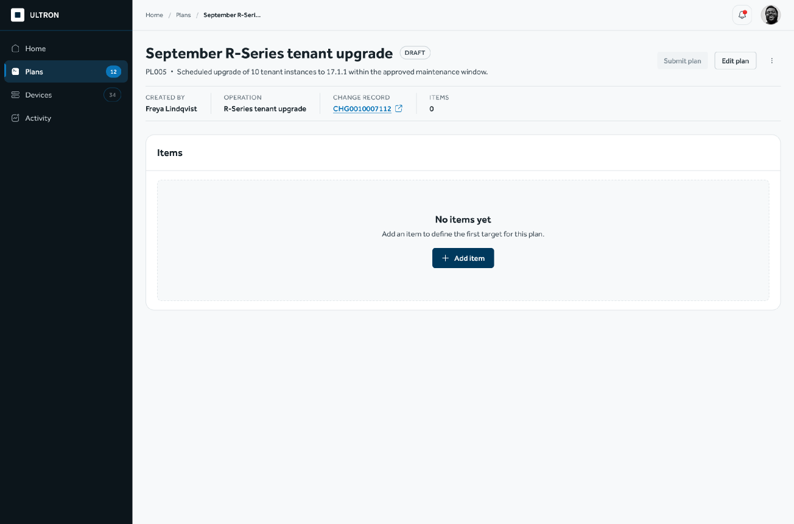
Add items
The plan opens as a draft
Add the targets one by one. Nothing runs until the plan is submitted, so the draft can be changed freely.
STEP 3 OF 8
Find your work
Create the plan
Add items
Submit and validate
Wait for the window
Run and monitor
Handle exceptions
See the outcome
Internal use only

Slide 8
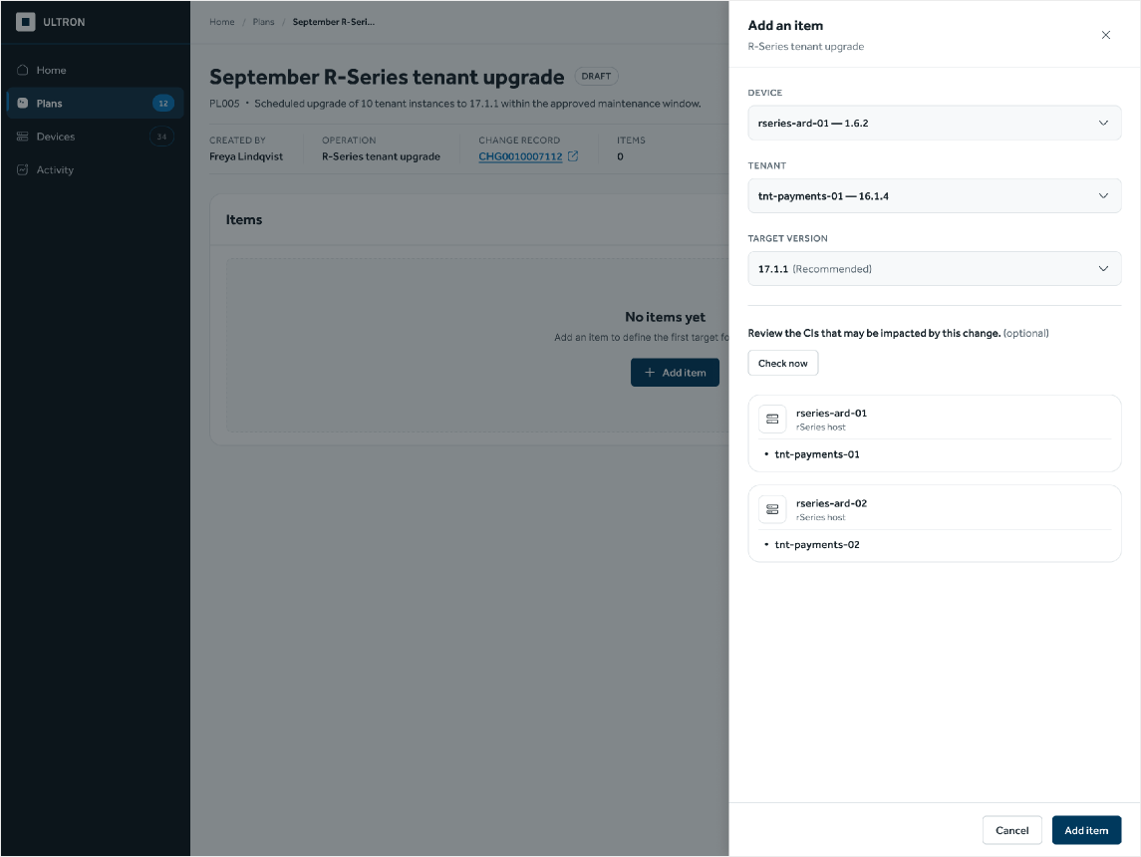
Add items
Add an item and see its impact
Choose the device, tenant and target version. The impact check lists everything the change touches before the item is added.
STEP 3 OF 8
Find your work
Create the plan
Add items
Submit and validate
Wait for the window
Run and monitor
Handle exceptions
See the outcome
Internal use only

Slide 9
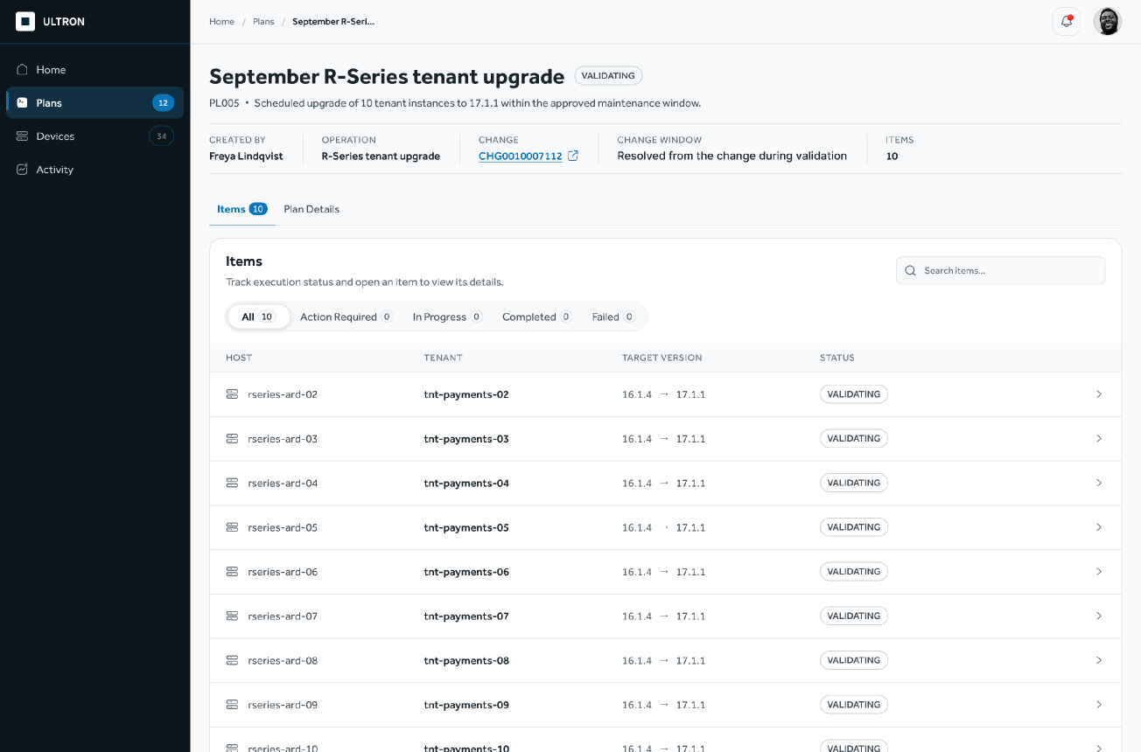
Submit and validate
Submit, and the system checks it
The plan details and every item are validated. If anything is wrong, the plan comes back with the errors marked, ready to fix.
STEP 4 OF 8
Find your work
Create the plan
Add items
Submit and validate
Wait for the window
Run and monitor
Handle exceptions
See the outcome
Internal use only

Slide 10

Wait for the window
Scheduled until the window opens
Validation passed and the change record is in place. The plan waits for its change window.
STEP 5 OF 8
Find your work
Create the plan
Add items
Submit and validate
Wait for the window
Run and monitor
Handle exceptions
See the outcome
Internal use only

Slide 11
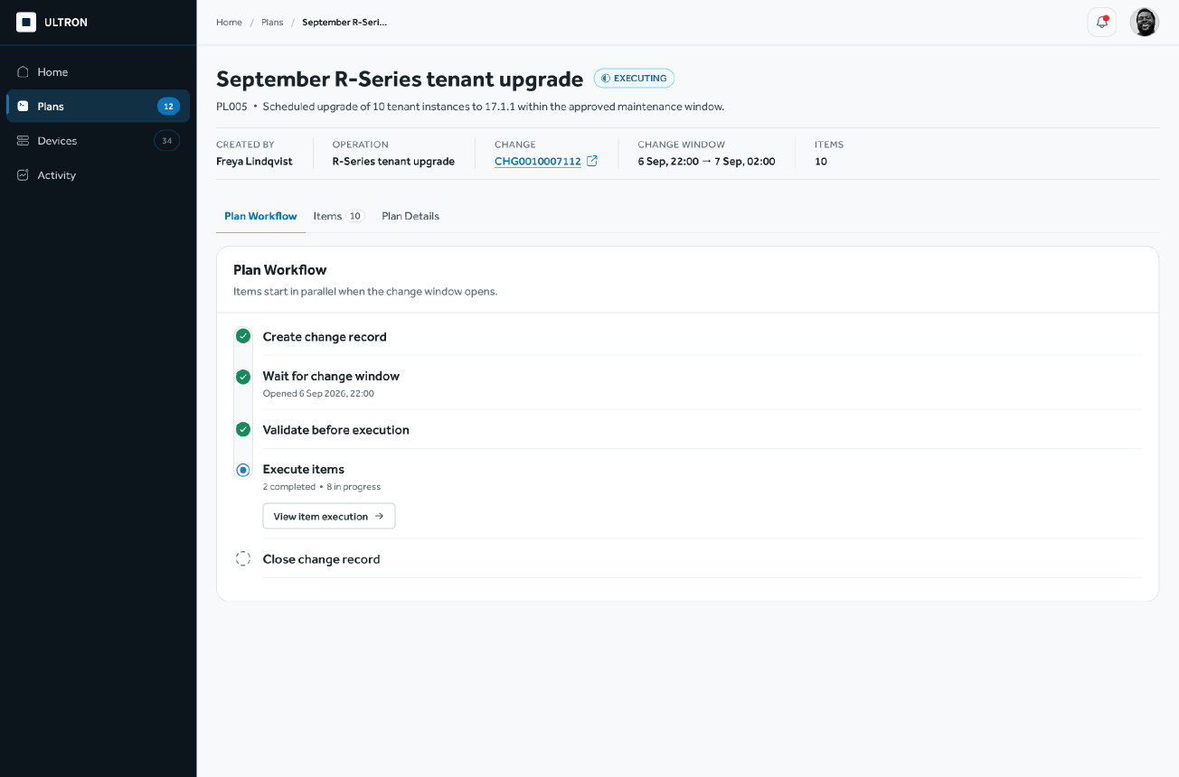
Run and monitor
The plan runs when the window opens
The plan workflow starts and items run in parallel. Each step shows where the plan stands.
STEP 6 OF 8
Find your work
Create the plan
Add items
Submit and validate
Wait for the window
Run and monitor
Handle exceptions
See the outcome
Internal use only

Slide 12
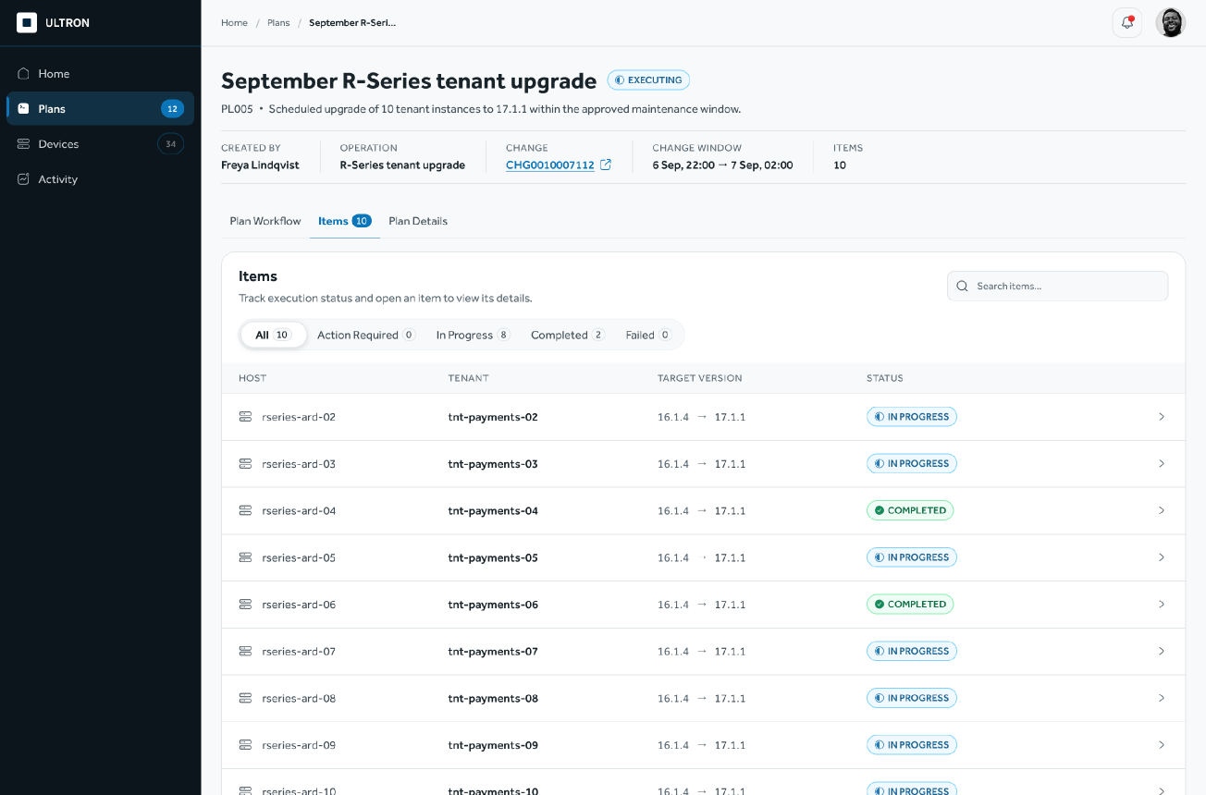
Run and monitor
Every item at a glance
Filter by what needs action, what failed, what is running and what is done. Open any item for its detail.
STEP 6 OF 8
Find your work
Create the plan
Add items
Submit and validate
Wait for the window
Run and monitor
Handle exceptions
See the outcome
Internal use only

Slide 13
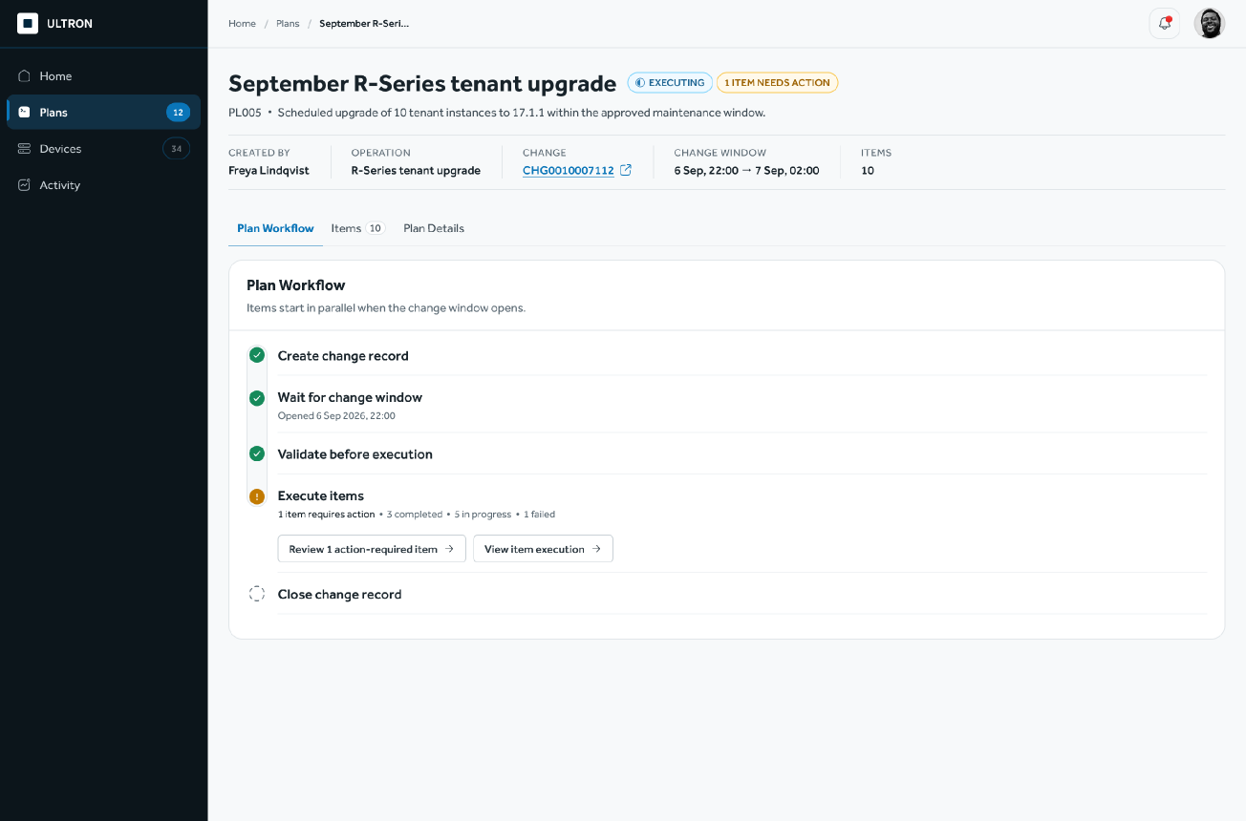
Handle exceptions
One item needs a decision
The plan keeps running. The item that stopped is called out, one click away from its detail.
STEP 7 OF 8
Find your work
Create the plan
Add items
Submit and validate
Wait for the window
Run and monitor
Handle exceptions
See the outcome
Internal use only

Slide 14
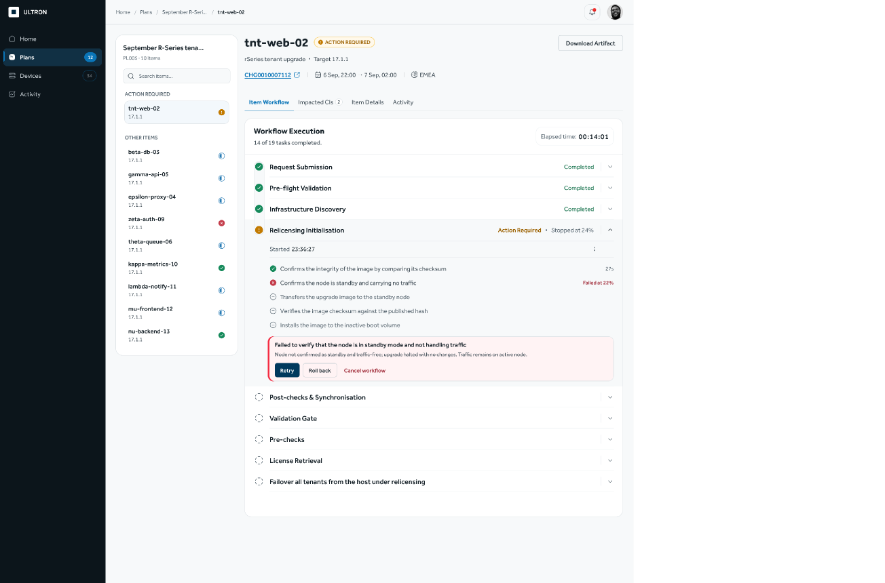
Handle exceptions
Everything needed to decide
The stopped task shows where and why it failed. The operator chooses Retry, Roll back or Cancel.
STEP 7 OF 8
Find your work
Create the plan
Add items
Submit and validate
Wait for the window
Run and monitor
Handle exceptions
See the outcome
Internal use only

Slide 15
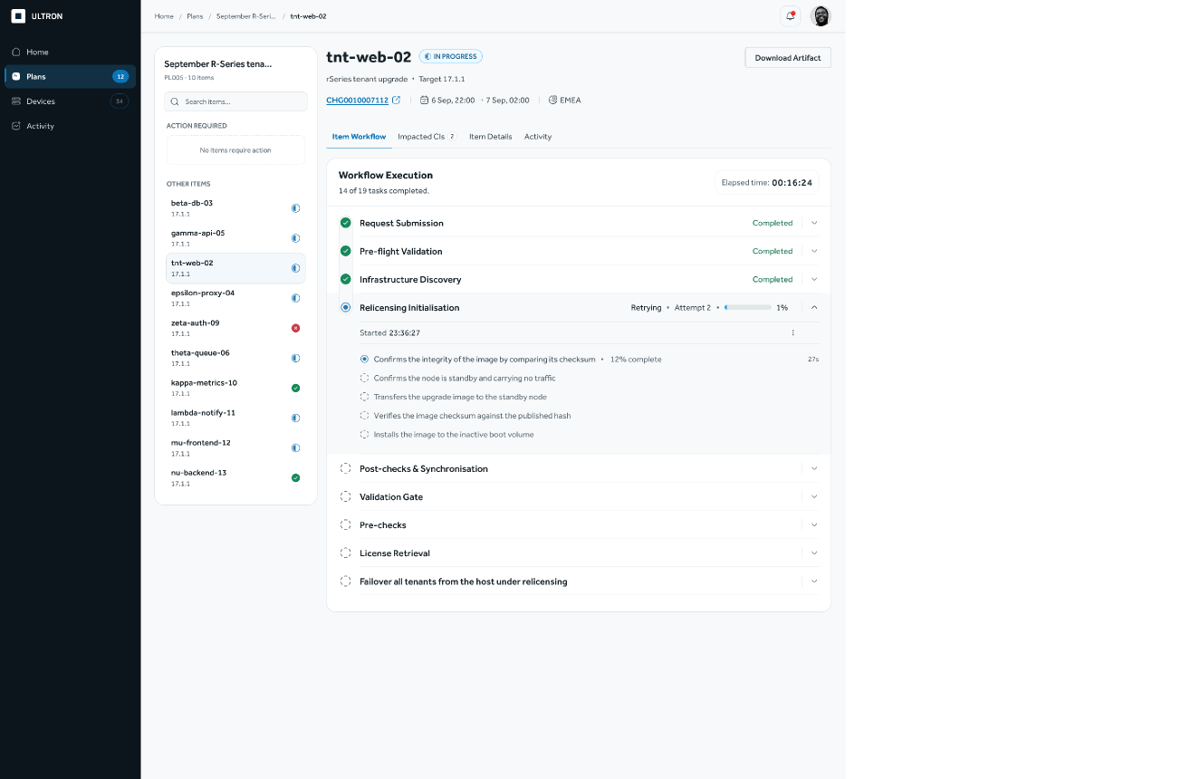
Handle exceptions
Retry runs the task again
Retry restarts the whole task from its first milestone, and the item returns to In Progress.
STEP 7 OF 8
Find your work
Create the plan
Add items
Submit and validate
Wait for the window
Run and monitor
Handle exceptions
See the outcome
Internal use only

Slide 16
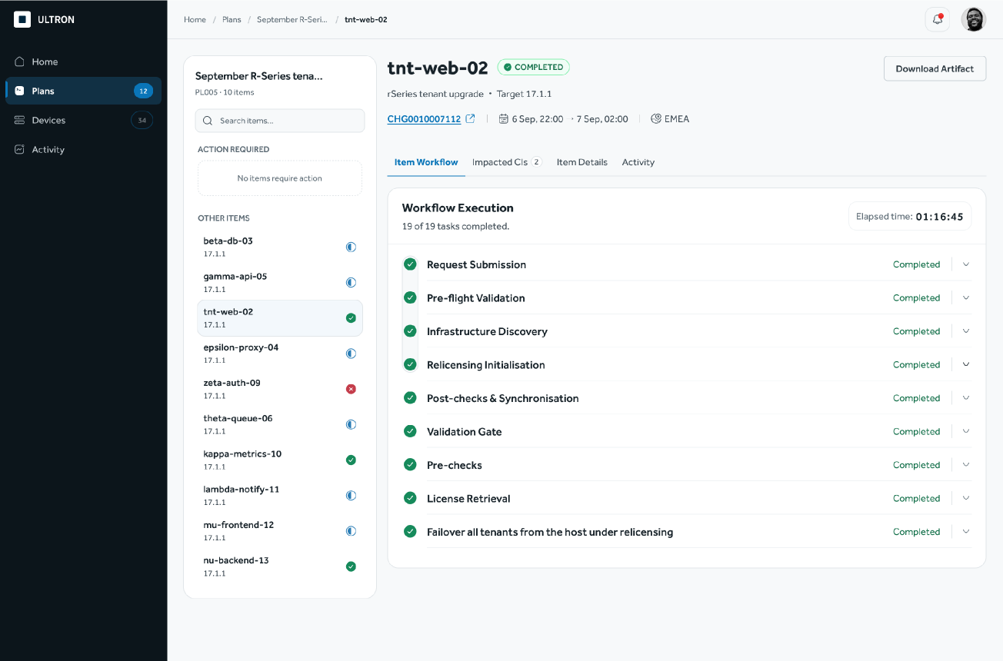
See the outcome
The item completes
Every task has finished and the item is marked Completed.
STEP 8 OF 8
Find your work
Create the plan
Add items
Submit and validate
Wait for the window
Run and monitor
Handle exceptions
See the outcome
Internal use only

Slide 17
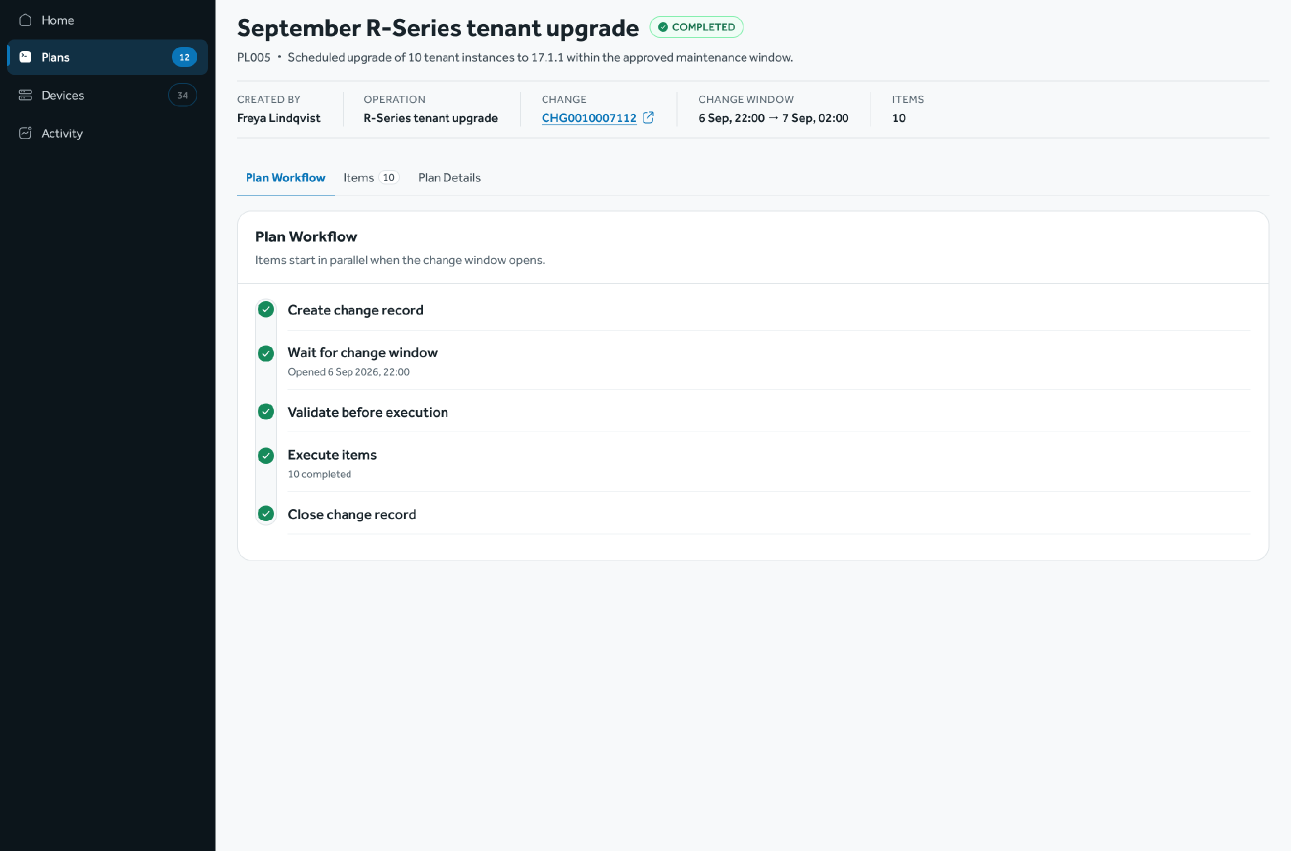
See the outcome
The plan closes
When every item has finished, the change record is closed and the plan shows its outcome.
STEP 8 OF 8
Find your work
Create the plan
Add items
Submit and validate
Wait for the window
Run and monitor
Handle exceptions
See the outcome
Internal use only

Slide 18
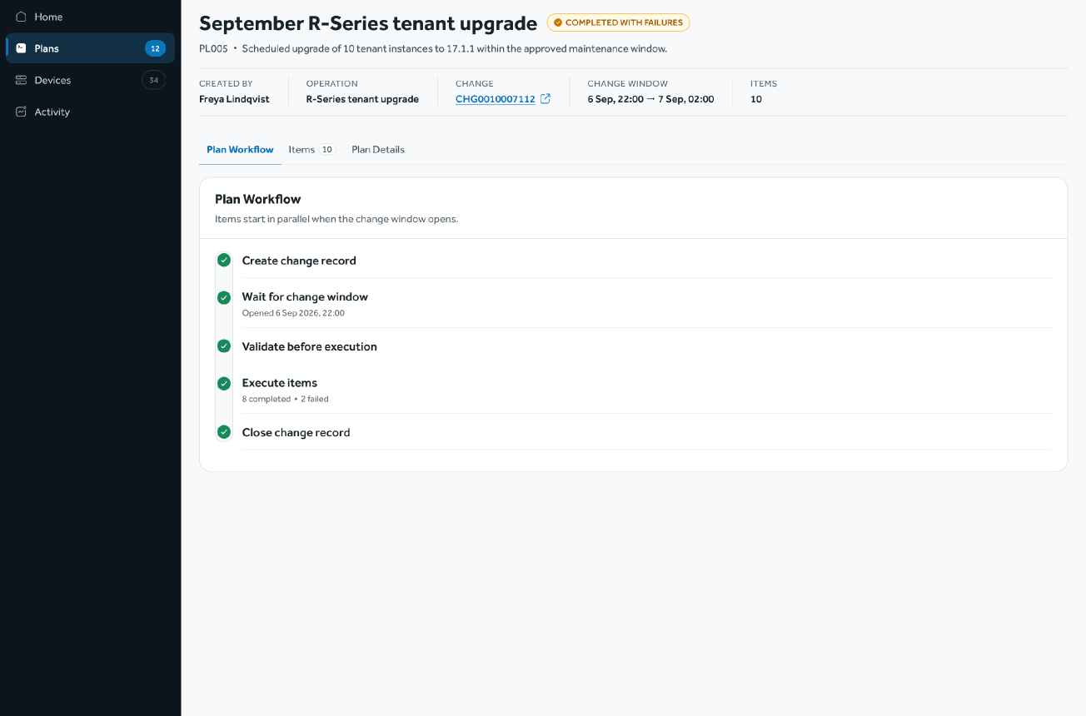
See the outcome
When not every item succeeds
The plan finishes as Completed with failures. The Items tab shows exactly which items did not complete.
STEP 8 OF 8
Find your work
Create the plan
Add items
Submit and validate
Wait for the window
Run and monitor
Handle exceptions
See the outcome
Internal use only

Slide 19
Let's take a look at the actual scenario of creating plan for firewall
Internal use only

Slide 20
Firewall upgrade
From many firewalls to one plan
Five choices narrow the fleet down to the right firewalls. Every firewall picked becomes its own item in the plan.
01
02
03
04
05
Manager
ADOM
Platform
Target version
Firewalls
Pick the manager that holds the firewalls
Choose the administrative domain inside it
Narrow to one firewall model
Set the version every firewall moves to
Tick every firewall that needs it, or Select all
Then the plan is submitted, validated and run like any other plan.
Internal use only

Slide 21
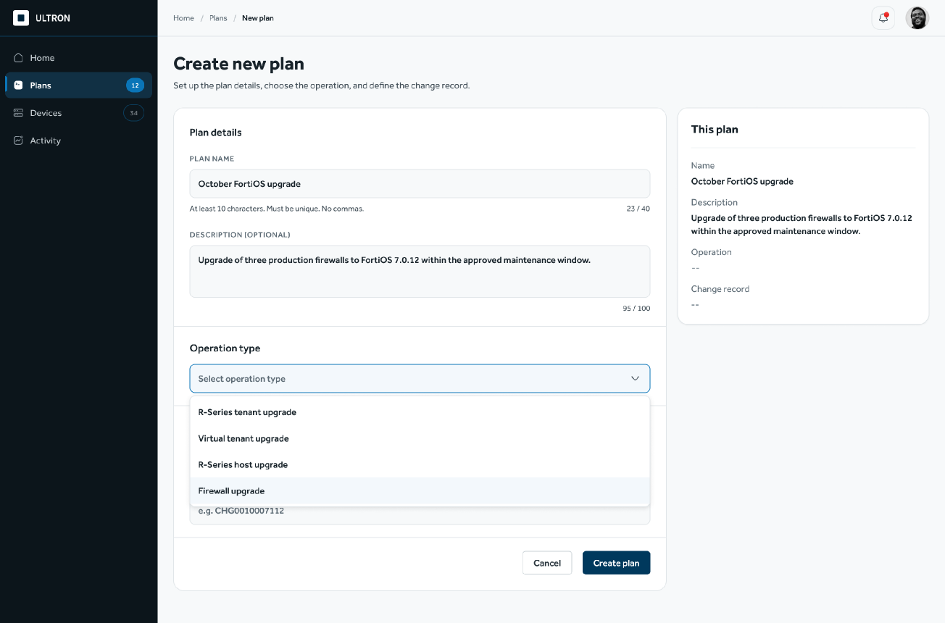
Create the plan
Firewall upgrade, same journey
Firewall upgrade is one more operation type in the same create form. Name, description and change record work exactly as before.
STEP 2 OF 8
Find your work
Create the plan
Add items
Submit and validate
Wait for the window
Run and monitor
Handle exceptions
See the outcome
Internal use only

Slide 22
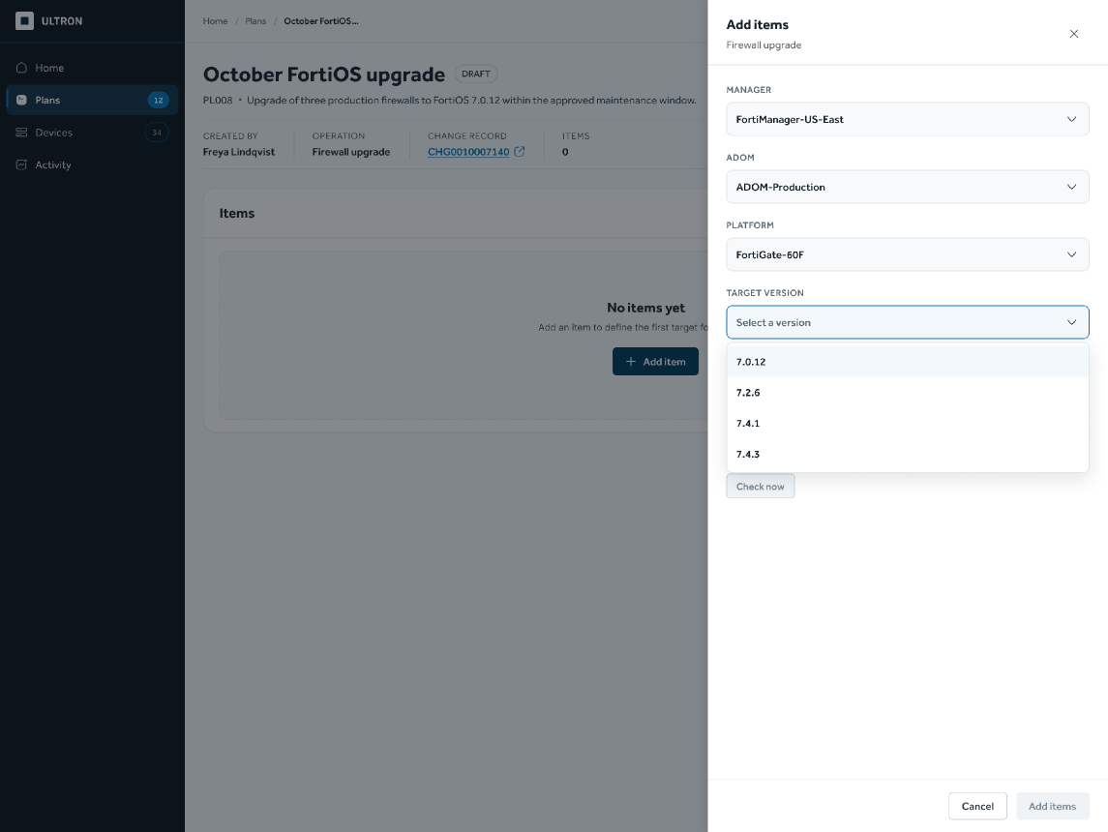
Add items
Narrow down to the right firewalls
Manager, ADOM, platform, then target version. Each field opens only after the one above it, so the list that follows is already filtered.
STEP 3 OF 8
Find your work
Create the plan
Add items
Submit and validate
Wait for the window
Run and monitor
Handle exceptions
See the outcome
Internal use only

Slide 23
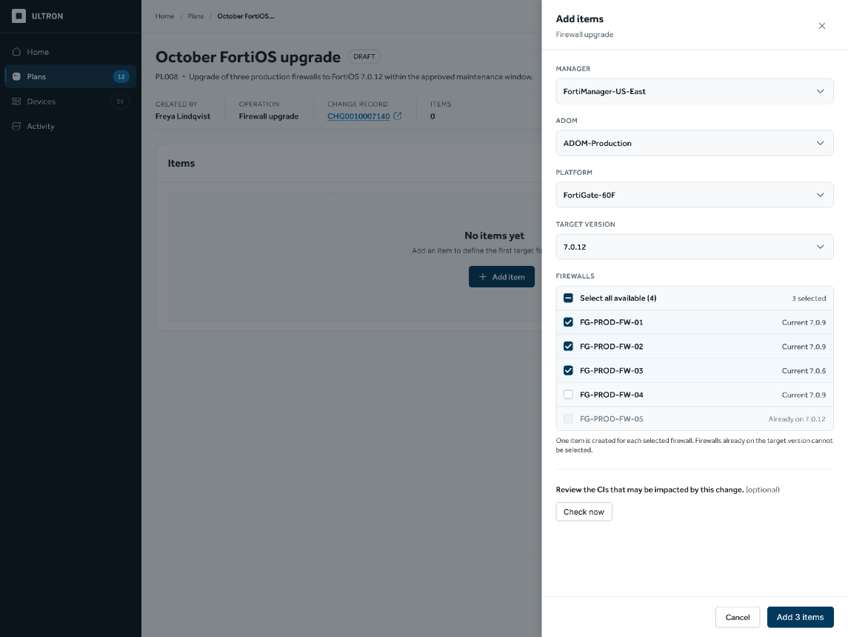
Add items
Pick several firewalls in one go
Every eligible firewall is listed with its current version. Select all, or tick the ones needed; one already on the target version cannot be picked.
STEP 3 OF 8
Find your work
Create the plan
Add items
Submit and validate
Wait for the window
Run and monitor
Handle exceptions
See the outcome
Internal use only

Slide 24
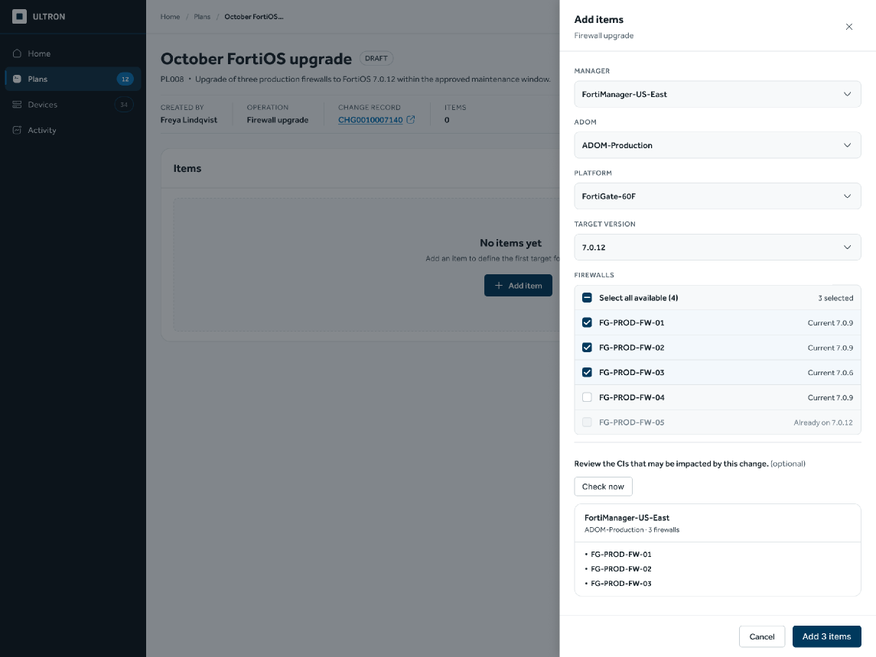
Add items
See the impact before adding
An optional check lists the selected firewalls under their manager and ADOM before anything is added.
STEP 3 OF 8
Find your work
Create the plan
Add items
Submit and validate
Wait for the window
Run and monitor
Handle exceptions
See the outcome
Internal use only

Slide 25
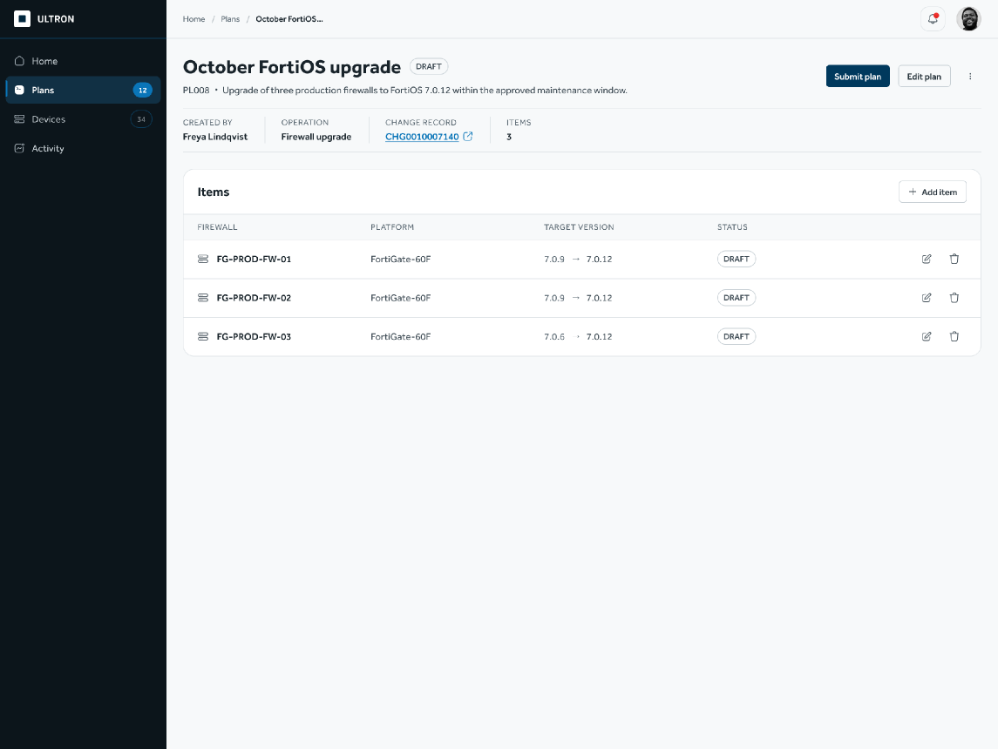
Add items
One item per firewall
Three firewalls become three items in the draft. Each can be edited or removed until the plan is submitted.
STEP 3 OF 8
Find your work
Create the plan
Add items
Submit and validate
Wait for the window
Run and monitor
Handle exceptions
See the outcome
Internal use only

Slide 26
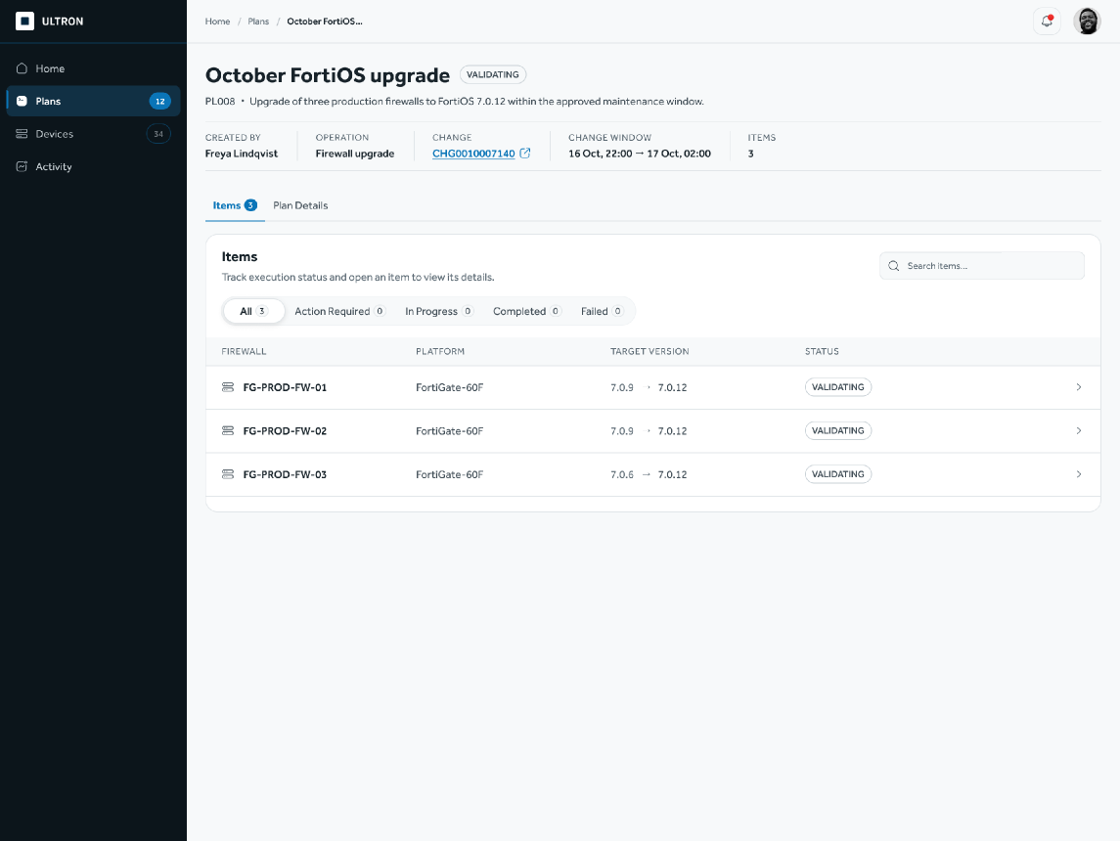
Submit and validate
Submit, and the system checks it
From here the firewall plan follows the same lifecycle as every other plan: validation, the change window, then execution.
STEP 4 OF 8
Find your work
Create the plan
Add items
Submit and validate
Wait for the window
Run and monitor
Handle exceptions
See the outcome
Internal use only

Slide 27

Thank you
Questions and feedback welcome.
Internal use only

